Slide 1
Board Status Update Las Lomitas Elementary School District Measure R Bond Program Project Status Update
Presented By:
Mike Wassermann, CPM
May 11th, 2022

Slide 2
AGENDA
Budget Update
Schedule Update
Website Update
Next Steps

Slide 3
La Entrada Budget Update
At the April Board meeting, XL Construction’s Facility and Site leases were approved.
CPM updated budgets as follows:
La Entrada Modernization
Construction Budget = $20,195,761
“Soft Cost” Budget = $4,087,030
Construction Contingency = $1,023,979
Project Contingency = $399,250
Total Project Budget = $25,706,020

Slide 4
Las Lomitas Budget Update
At the April Board meeting, XL Construction’s Facility and Site leases were approved.
CPM updated budgets as follows:
Las Lomitas Modernization
Construction Budget = $17,750,561
“Soft Cost” Budget = $3,127,344
Construction Contingency = $903,400
Project Contingency = $351,100
Total Project Budget = $22,132,405

Slide 5
Budget Update - Contingencies
Budgeted La Entrada Contingencies = $1,423,228
LE Contingencies Included in Lease = $1,657,315
Total LE Contingencies = $3,080,543
Budgeted Las Lomitas Contingencies = $1,254,500
LL Contingencies Included in Lease = $1,291,438
Total LL Contingencies = $2,545,938
TOTAL $5,626,481

Slide 6
La Entrada Proposed Schedule
Phase 1 (Underground Pathways): June 20, 2022 – August 19, 2022
Phase 2 (Wing 5): June 20, 2022 – November 10, 2022
Phase 3 (Wings 1 and 2): November 16, 2022 – March 12, 2023
Phase 4 (Wings 3 and 4): April 24, 2023 – September 19, 2023
Phase 5A (Admin and Jensen): June 20, 2023 – September 21, 2023
Phase 5B (Library and Gymnasium): June 20, 2023 – August 21, 2023

Slide 7
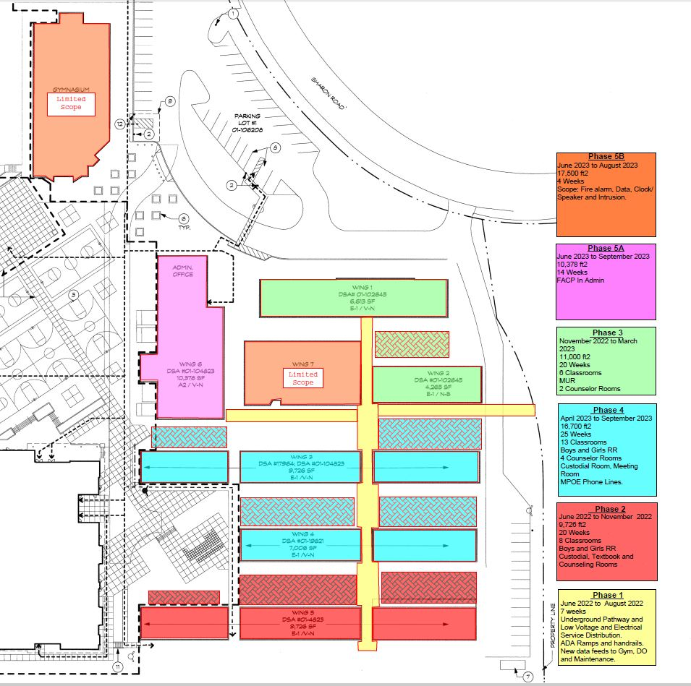
La Entrada Sample Phasing Plan and Schedule

Slide 8
Las Lomitas Proposed Schedule
Phase 1 (Wings 5, 6 and 7): June 21, 2022 – October 20, 2022
Phase 2 (Wings 1, 2 and 9): November 4, 2022 – March 8, 2023
Phase 3 (Wings 3, 4 and 8): April 14, 2023 – August 15, 2023
Phase 4 (Cano Hall, Library and 2 Story): June 21, 2023 – August 23, 2023

Slide 9
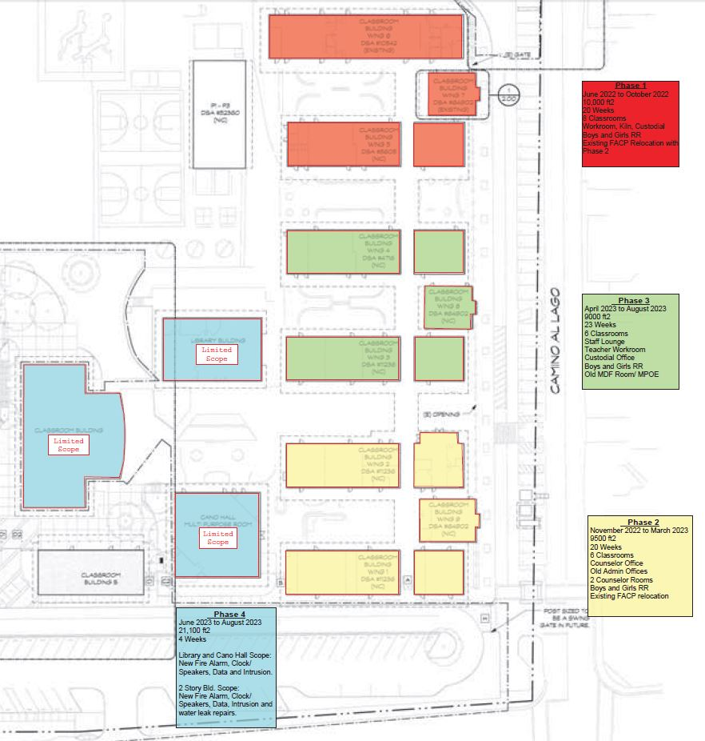
Las Lomitas Sample Phasing Plan and Schedule

Slide 10
What to Expect
The school sites are Educational facilities first and a construction site second.
There will be NO changes to the pick-up and drop off.
There will be NO changes to the site access.
There will be NO changes to the school schedules.
There will be NO impact to the school play fields.
There will be NO impact to the school hard courts.
First phase of classrooms already moved to Interim Housing.
Each phase will be fenced off from the students.
All Contractors will be supervised by DOJ cleared staff.
Neighbors will be notified of upcoming work.

Slide 11
Website Update
The Facilities Development portion of the website has been updated to include all of the most current information.
It includes information on budgets, schedules, project phasing and pick up/ drop off maps.
Simply click there directly with this link:
https://llesd-ca.schoolloop.com/facilitydevelopment

Slide 12
Next Steps
Commence with construction on June 20th.
Monitor Change Orders and use of contingencies for first 2 phases.
Start planning next projects based on estimate surplus contingencies:
Develop estimate of remaining contingencies.
Develop list of projects for District to prioritize.
Work with Board sub-committee to prioritize.
Obtain Board approval of prioritized project list.

Slide 13
Questions & Answers?

